Slide 1
Articles

Slide 2
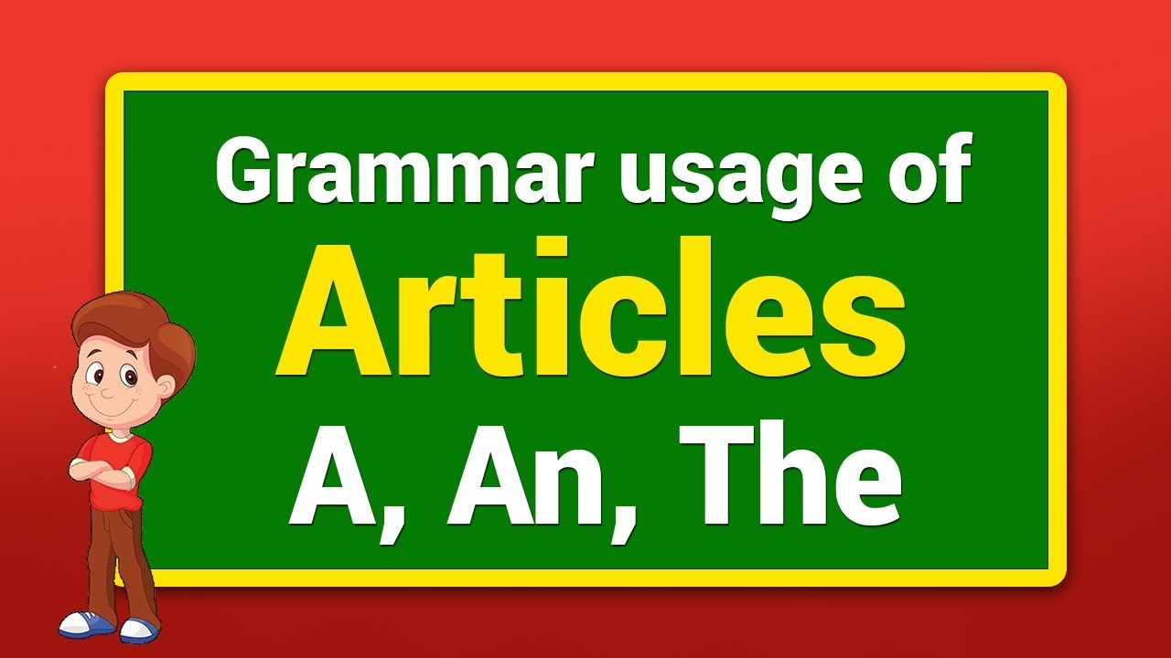

Slide 3
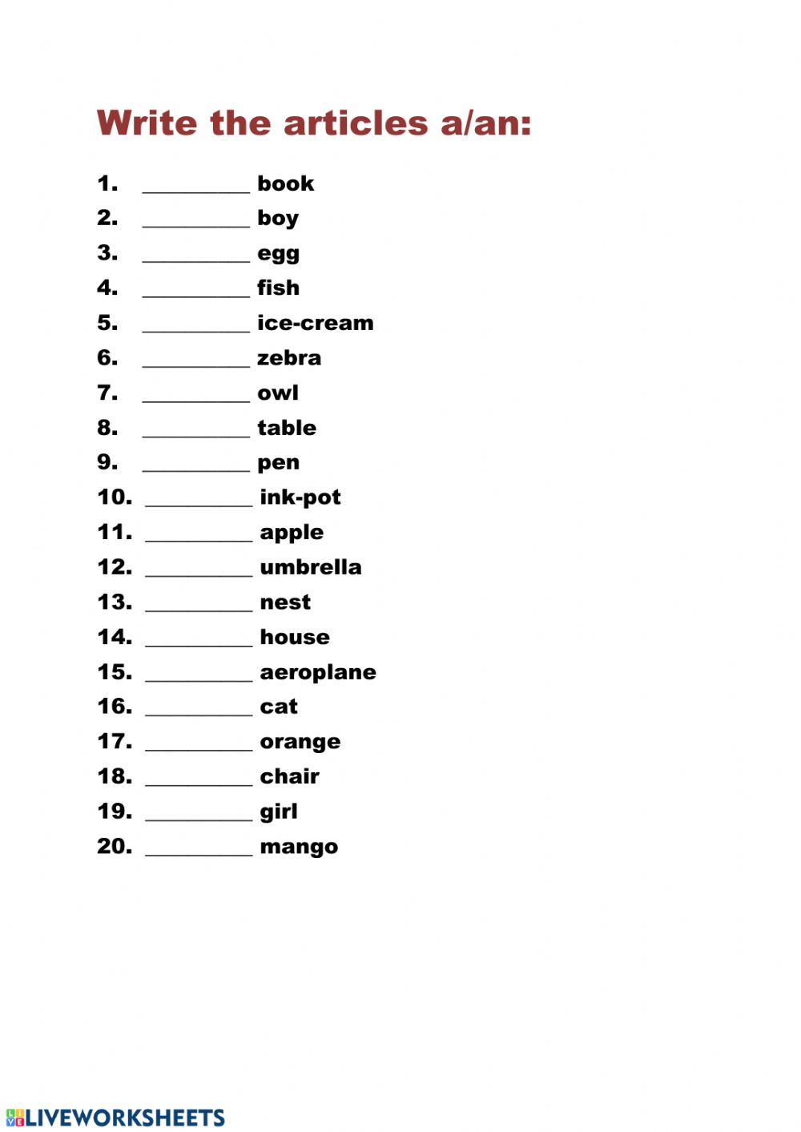

Slide 4
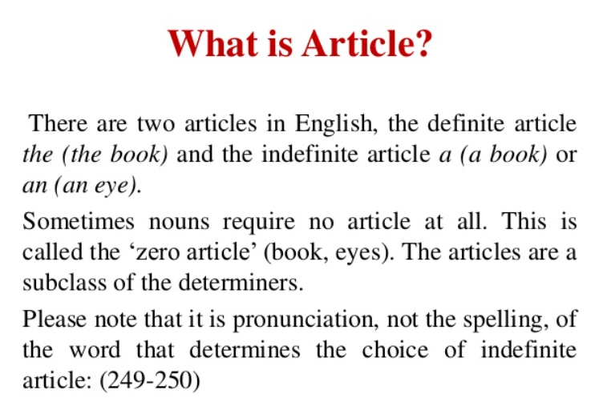

Slide 5
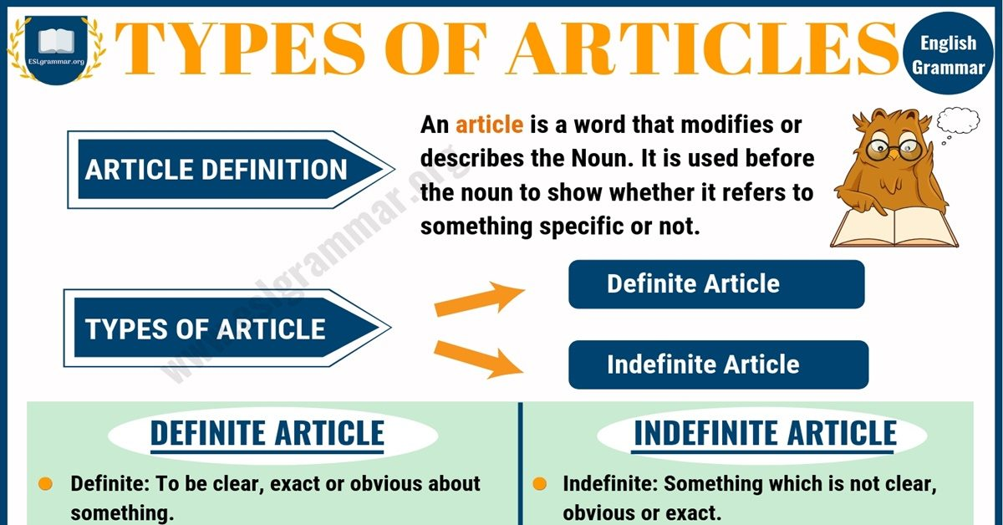

Slide 6
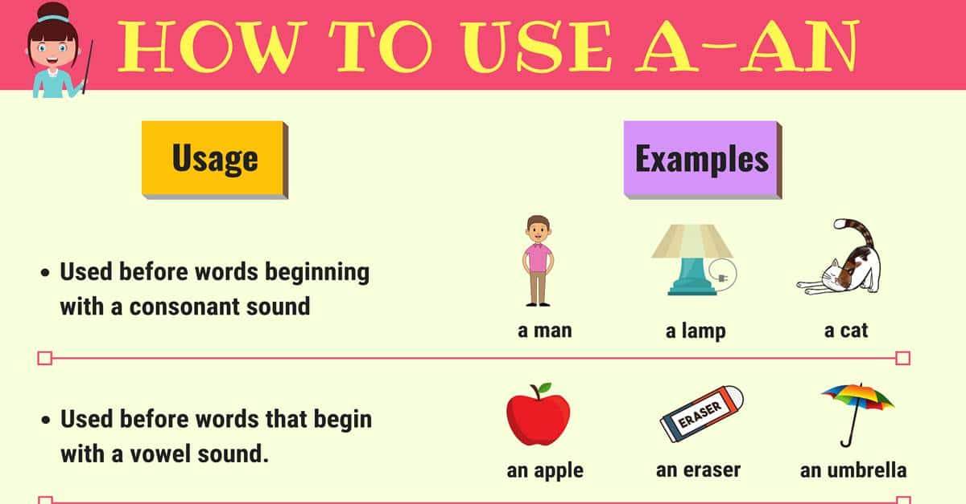

Slide 7
Rules for the use of the Indefinite article “A”

Slide 8
THREE BASIC USES OF INDEFINITE ARTICLE “a/an”
When you mention someone or something for the first time
Eg: I saw a rainbow yesterday
I consulted an optician yesterday
To show that someone or something is one of a group
Eg: It was a magnificent rainbow
He is an optician in London
When you say what someone’s job is
Eg: My mum is a nurse
Fred is a doctor

Slide 9
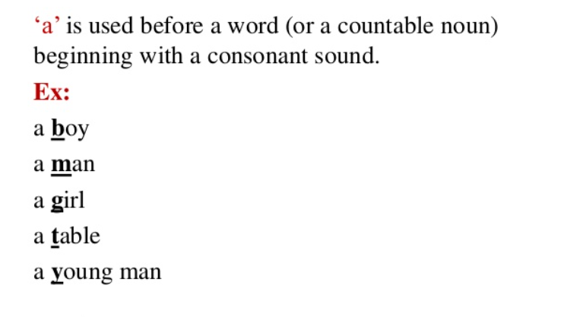

Slide 10
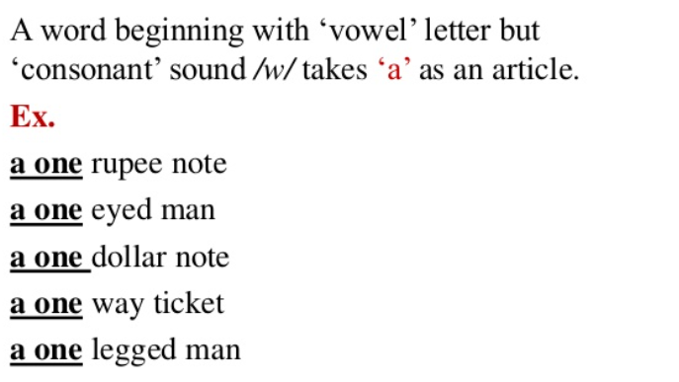

Slide 11
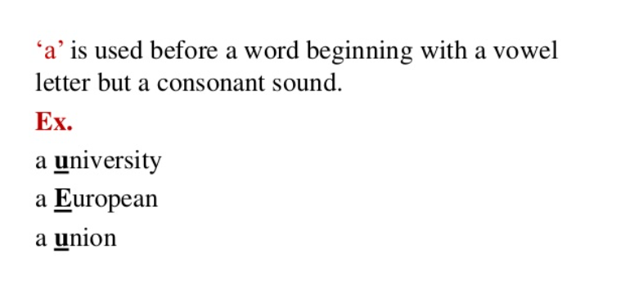

Slide 12
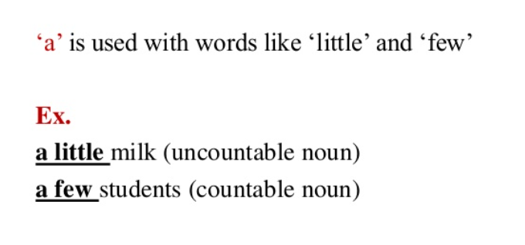

Slide 13
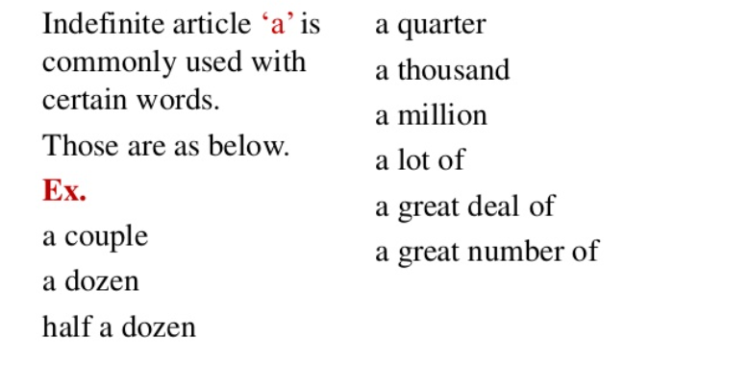

Slide 14
Rules for the use of the Indefinite article “An”

Slide 15
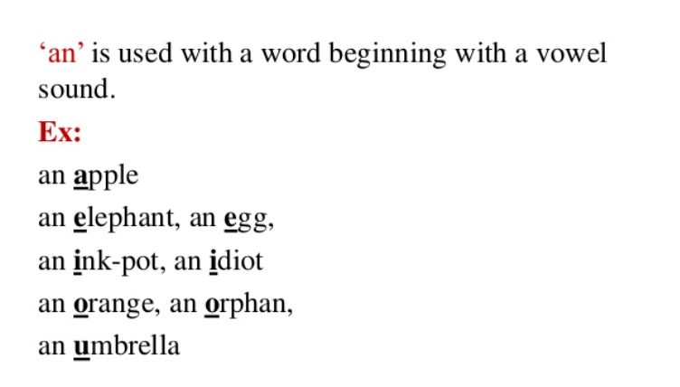

Slide 16
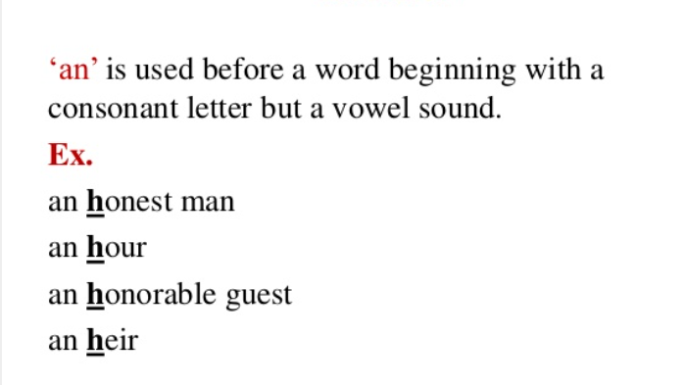

Slide 17
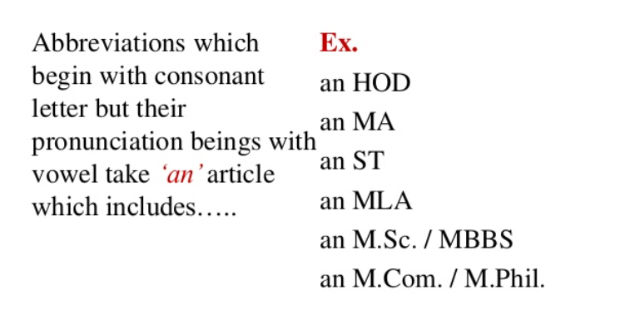

Slide 18
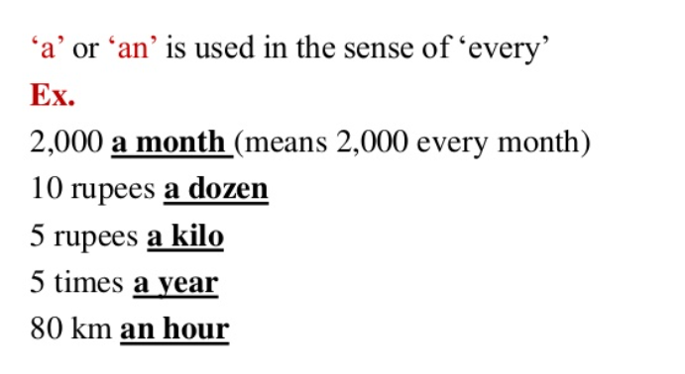

Slide 19
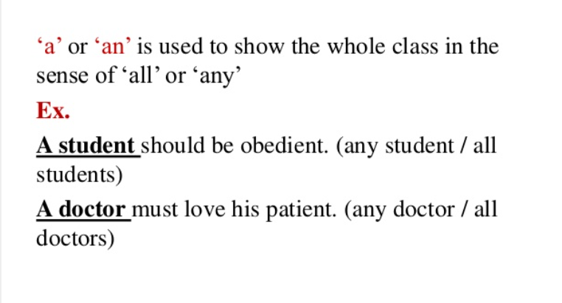

Slide 20
DON’TS OF A/AN
Do not use a/an with uncountable nouns like “rice, milk, cherries, information” etc.
Eg: He gave me an advice ( incorrect usage)
He gave me some advice.
Do not use a/an with plural nouns
Eg: I ate a cherries yesterday ( incorrect usage)
I ate some cherries
We use “the” before uncountable and plural nouns
Eg: The rice was delicious.
The cherries were tasty.

Slide 21
Rules for the use of the definite article “THE”

Slide 22
TO TALK ABOUT SPECIFIC PERSON OR THING
The book you want is out of print
Let us go to the park
The girl cried

Slide 23
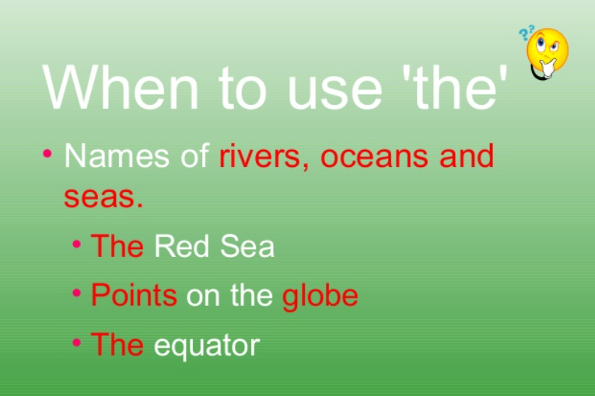

Slide 24
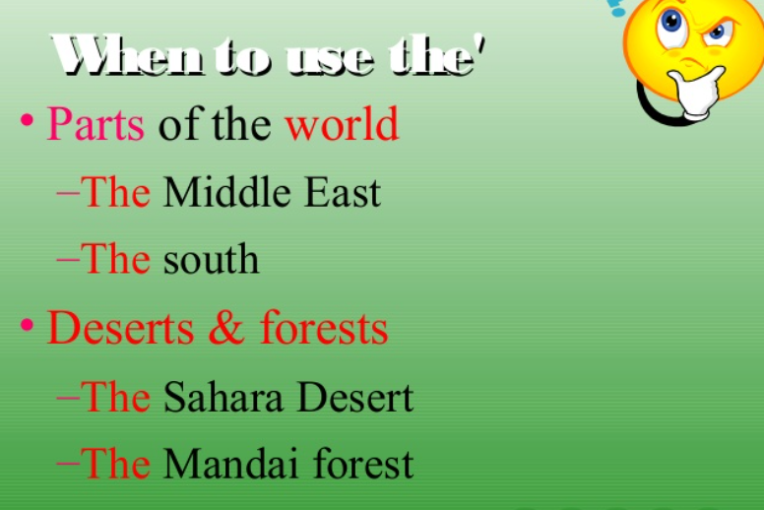

Slide 25
Before musical Instruments
Before musical Instruments ( in British English not in American English)
Eg: He can play the flute
They know to play the violin
With adjectives used as nouns
Eg: The rich are unhappy.
We gave food to the elderly.
With superlative adjectives
Eg: Mt. Everest is the highest mountain peak
Before unique things
The sun, the moon, the earth.
With newspapers
I read the Hindu/ the Herald Tribune
With well known buildings, historical places work of art and families an
Eg: the Taj Mahal, the High Court, the Secretariat the Mona Lisa, the Simpsons
With names of countries that have plural names
The Philippines , The Irish republic, The United Kingdom.

Slide 26
Mixed categories
That need “the”
That does not need “The”
With some organizations
Eg: the Red Cross, the European Union
If the name starts with ‘university’
Eg: The University of Bath
Note: if the name does not start with university “the” is dropped.
Eg: Oxford University, Harvard University
Other Organizations
Eg: Amnesty International, Green Peace
Note: if the abbreviation is used as an acronym “the” is dropped.
Eg: The World Health Organization
NOT the WHO (you should never write the NATO unless it is an adjective as the NATO Report.)
With Transport
If you use ‘by’ there is no ‘the’ = go by train, go by car
Otherwise use ‘the’ = take the train, take the car

Slide 27
notes
How to pronounce the article ‘the’?
Pronounce it as /ðə/ (thuh) before all consonant sounds including
/j/ (you), /w/ (we), and /h/ (he)
Eg: The book, the door, the hotel, the week, the yellow purse
Pronounce it as /ði:/ (thee) when the next word begin with a vowel sound:
Eg: the apple, the orange, the ice-cream, the umbrella, the interest.

Slide 28
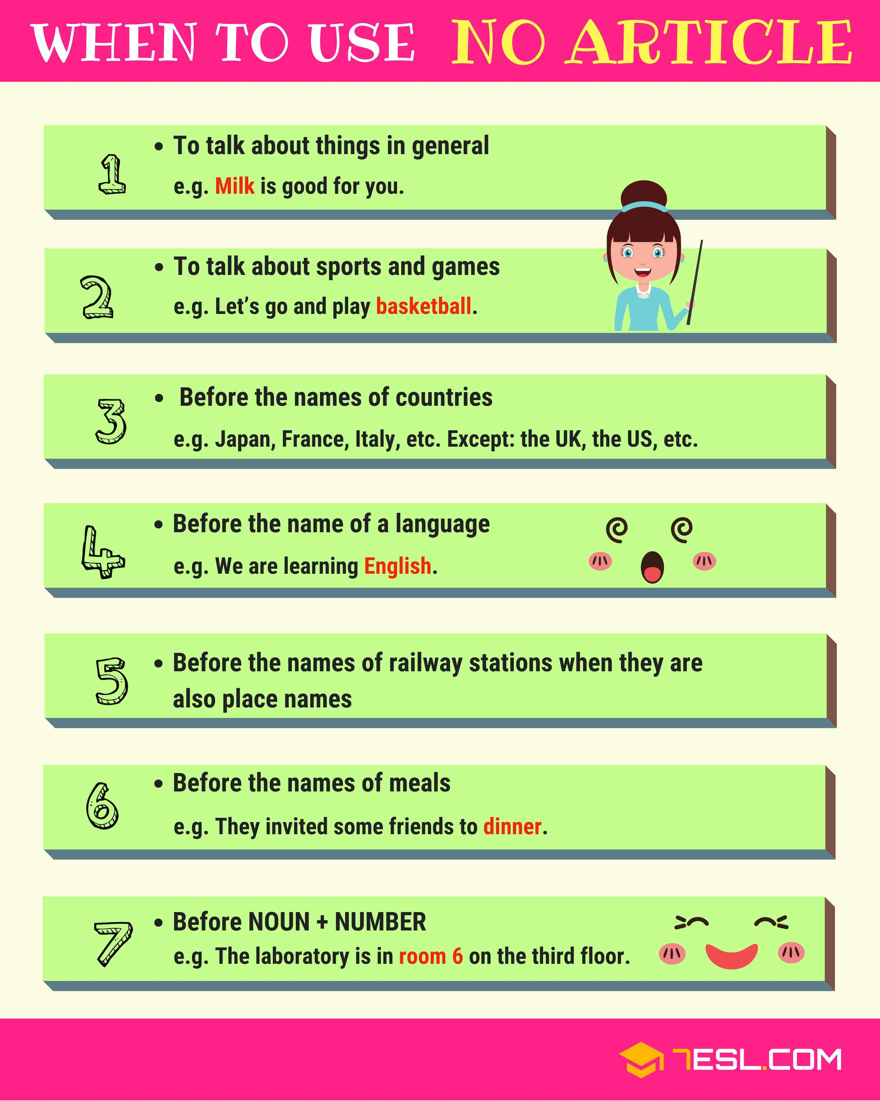

Slide 29
notes
Articles should not be used before school, college, university, church, hospital, jail, court, bed, market, etc. when these places are visited or used for their primary purpose.
Eg: He went to church,
He is in jail.
With cardinal numbers “ the” is not necessary: room 26, paragraph 8
With ordinal numbers “the” is necessary: the 3rd floor, the 7th line

Slide 30
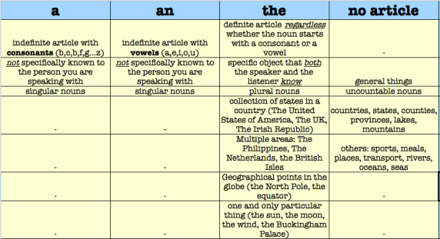

Slide 31
Fill in the blank with the appropriate article, a, an, or the, or leave the space blank if no article is needed:
1. He is _____ one eyed man.
2. ____ church on the corner is progressive.
3. Miss Lin speaks ____ Chinese.
4. She has decided to study _____ Political Science
5. One of the students said, "____ professor is late today."
6 Eli likes to play ____ volleyball.
7. The members of _____NATO rejected the idea.
8. My daughter is learning to play ____ violin at her school.
9. He has been to ______jail for ______second time.
10. Is your phone number 7832? No, there is _____ ‘1’ before _____‘8’.

Slide 32
Use the correct Articles
1. Copper is ___ useful metal
2. He is not ____ honourable man
3. Do you see ____ blue sky?
4. I first me him ___ year ago
5. Honest men speak ____ truth
6. she is ____MA graduate
7. Yesterday ____ European called me at the office
8. Is there _____’I’ your name.
9. I have been to _______Europe.
10. ____Ganga is _____ sacred river
11. I have _____ news for you.
12. These are ______ oranges you bought yesterday.

Slide 33
Thank You!

